Slide 1
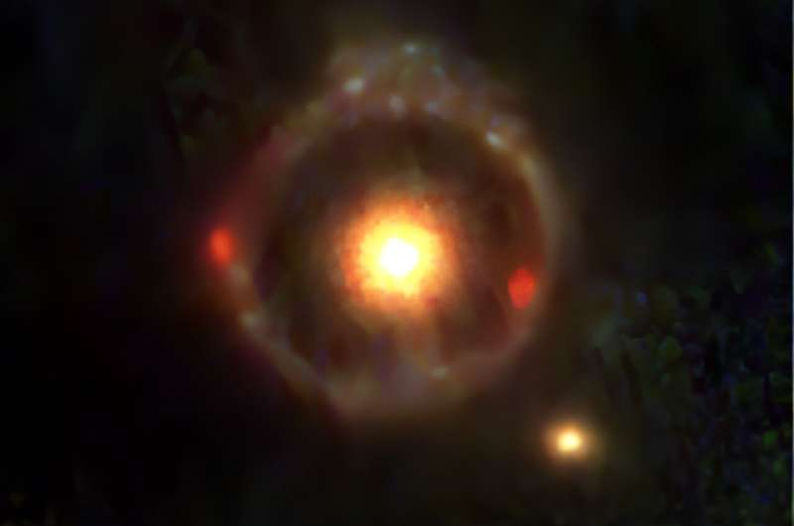
JWST-ER1: An Einstein Ring
Aavik Wadivkar, Isaac Gutierrez
https://www.nature.com/articles/s41550-023-02103-9

Slide 2
Table of contents
01
02
03
04
Einstein Rings?
JWST-ER1
what are they?
what is it?
Research
Conclusions
what did we do?
how did it go?

Slide 3
01
Einstein Rings

Slide 4
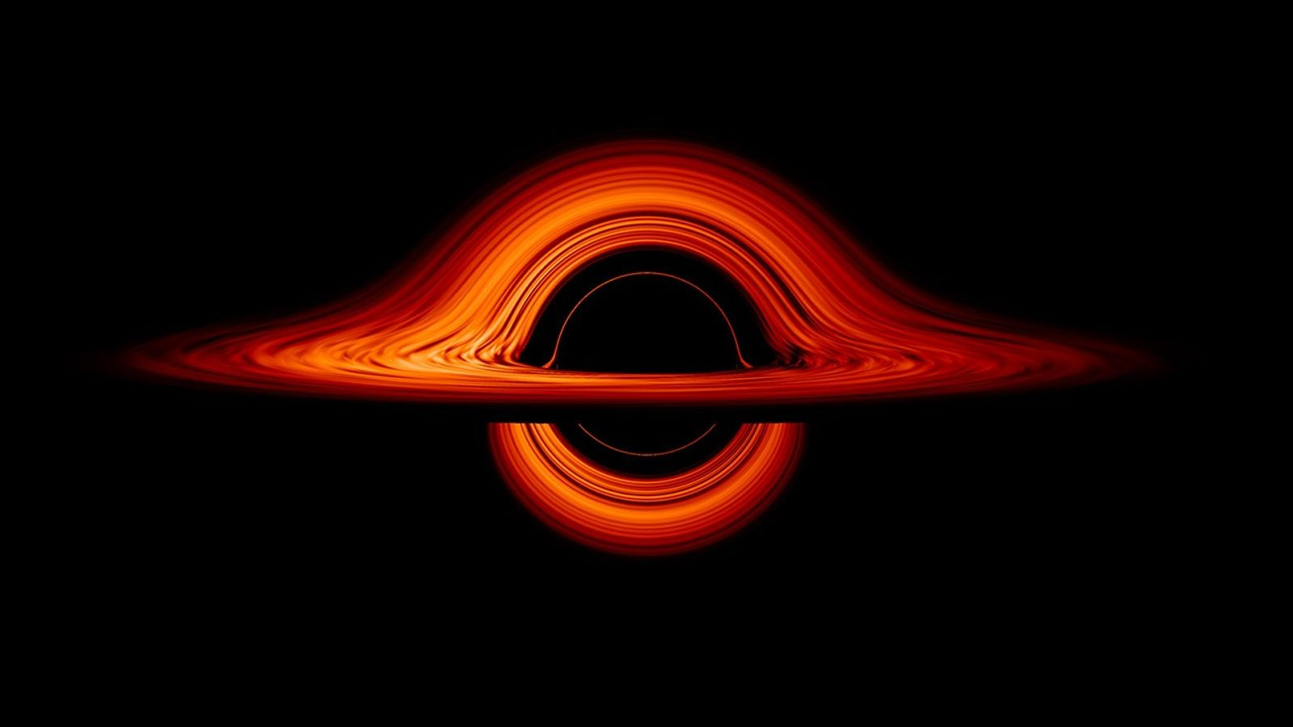
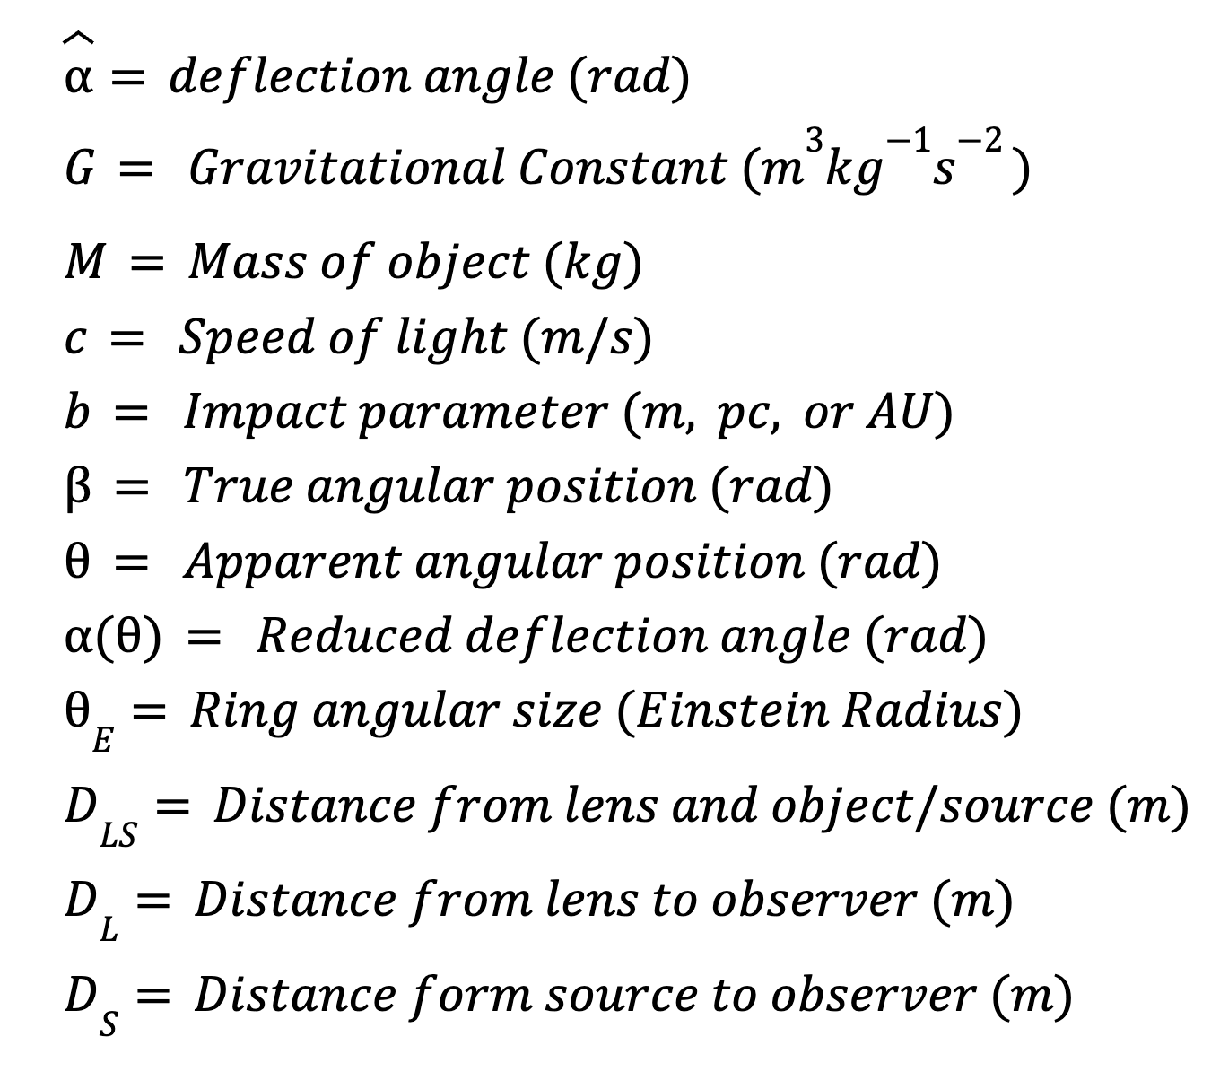
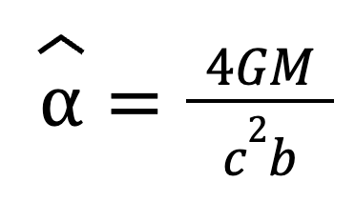
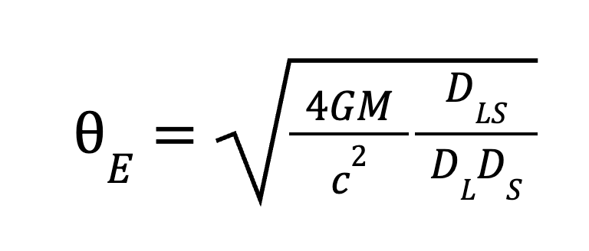
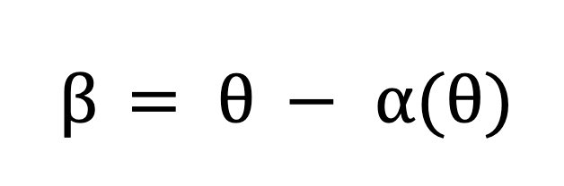
Gravitational Lensing
[1]
Definition: the bending of light due to spacetime curvature around a mass, causing background objects to appear magnified, distorted, or multiplied.
https://science.nasa.gov/universe/black-hole-week/
Lens Equation
Deflection Angle
Einstein Radius
Notes:
b = D_L theta, plug in (1), then plug that into (2) by relation alpha = D_LS / D_S a^ and setting beta to 0 (source is exactly behind lens), then multiply both sides by theta to get (3)

Slide 5
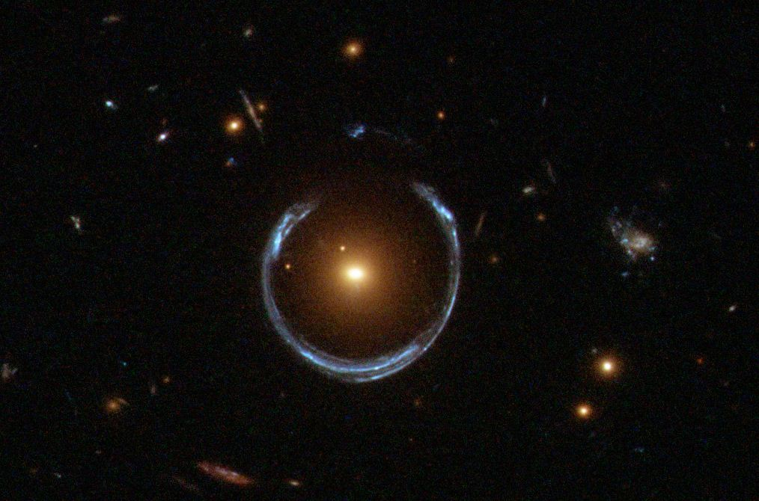

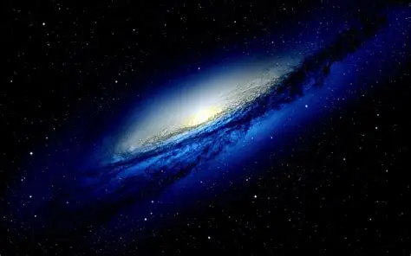

Slide 6
Some History (Proving GR)
[2]
Eddington Experiment:
Goal: test Einstein’s General Relativity by measuring how much starlight bends near the Sun.
Method: photograph stars during a total solar eclipse, when the Sun’s light is blocked.
Eddington led two expeditions to observe the eclipse:
Principe Island (off Africa)
Sobral, Brazil
During the eclipse, starlight passing near the Sun’s edge was measured and compared to their normal positions at night.
Newtonian gravity → 0.87 arcseconds of deflection
Einstein’s GR → 1.75 arcseconds
Observed deflection matched Einstein’s prediction, not Newton’s.
Result: first major experimental confirmation of General Relativity.

Slide 7
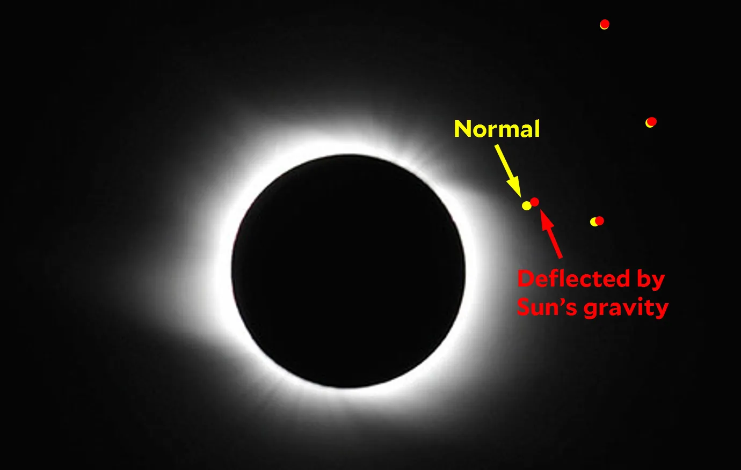

Slide 8
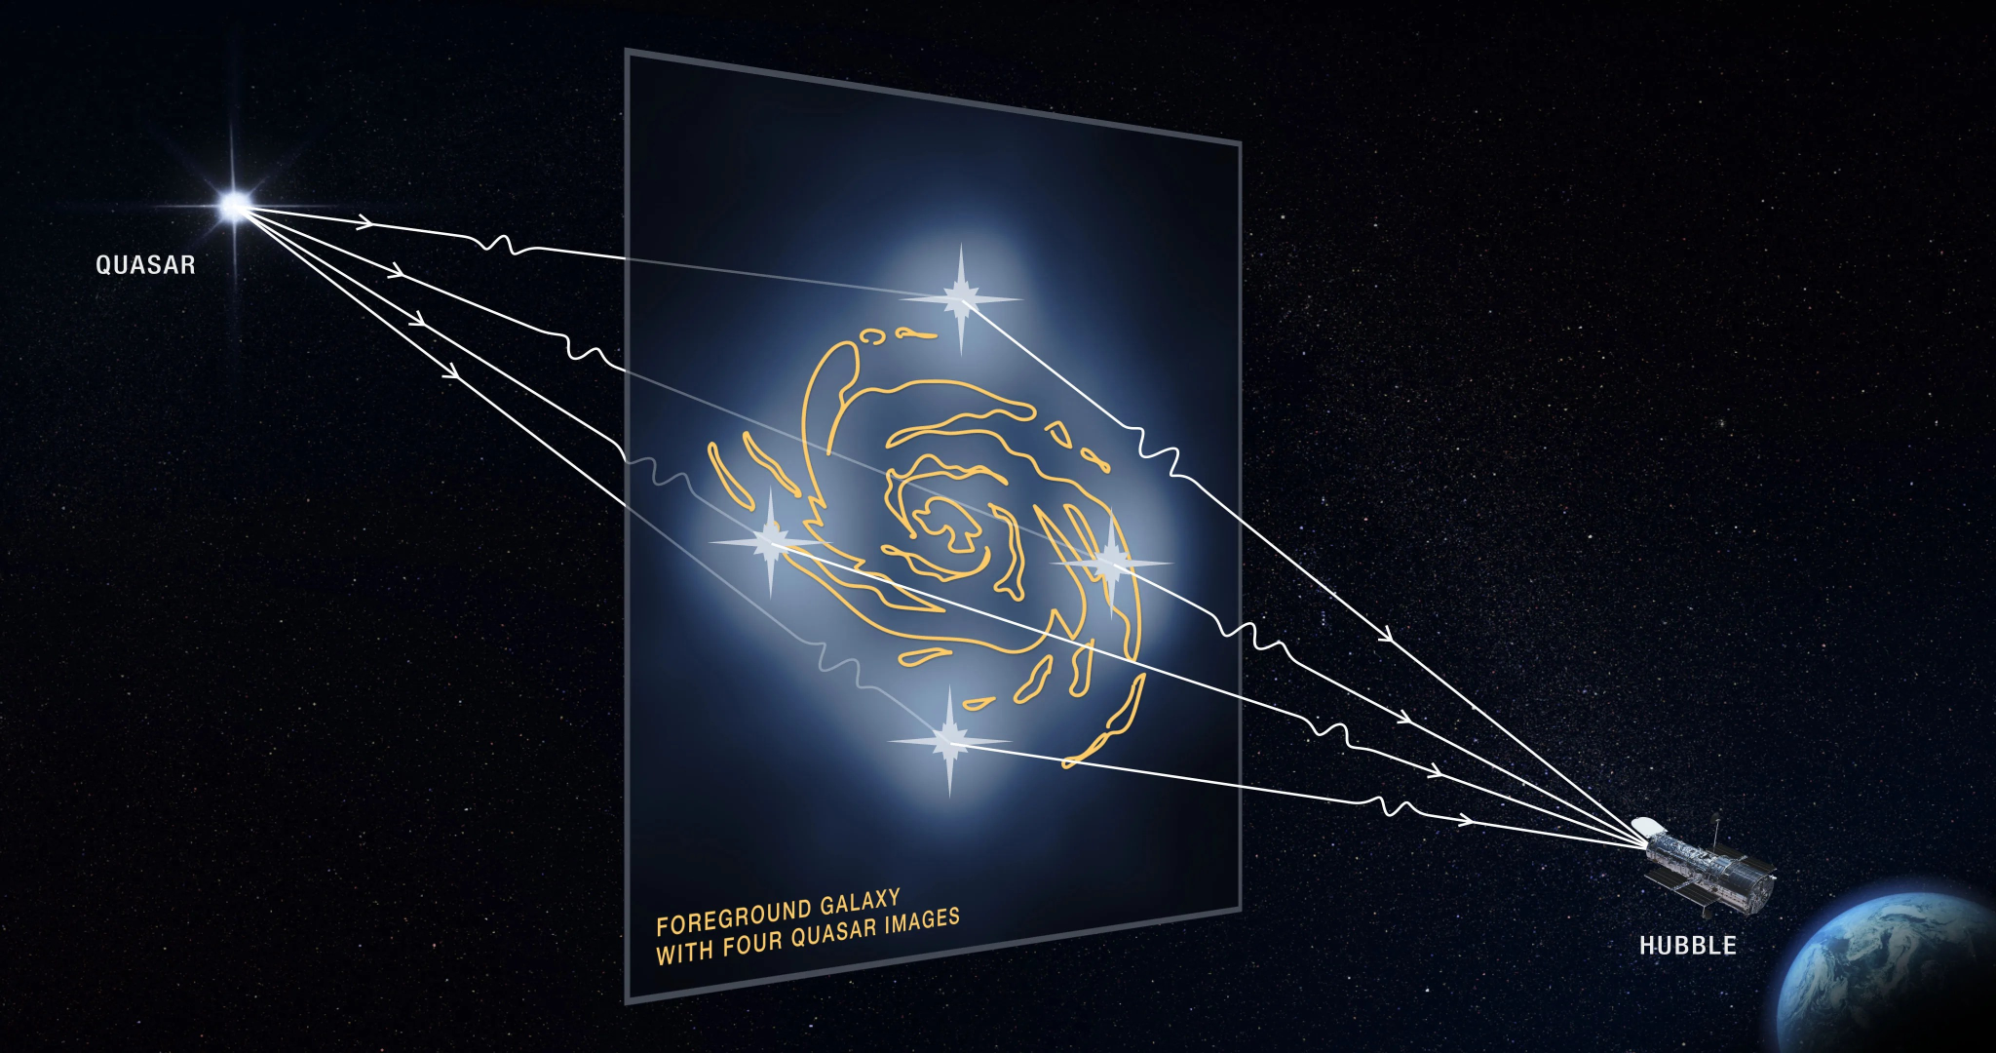
JWST-ER1
02
Known Features:
Lens Galaxy (JWST-ER1g):
Photometric redshift: z_l = 1.94 (+0.13 / −0.17)
Effective radius: r_e ≈ 1.9 ± 0.2 kpc
Sérsic index: n ≈ 5.0 ± 0.6
Stellar mass (within Einstein radius): ~1.1 × 10^11 solar masses
Total mass (within Einstein radius): ~6.5 × 10^11 solar masses
Dark-matter mass (same region): ~2.6 × 10^11 solar masses
Stellar population age: ~1.9 billion years
Star-formation rate: ~4 solar masses per year (quiescent)
Morphology: compact, round, early-type galaxy
Einstein Ring (JWST-ER1r):
Observed diameter: 1.54 arcsec ± 0.02
Corresponding physical radius: ~6.6 kpc
Background Source Galaxy:
Photometric redshift: z_s = 2.98 (+0.42 / −0.47)
[3-8]
https://science.nasa.gov/mission/hubble/science/science-behind-the-discoveries/hubble-gravitational-lenses/

Slide 9
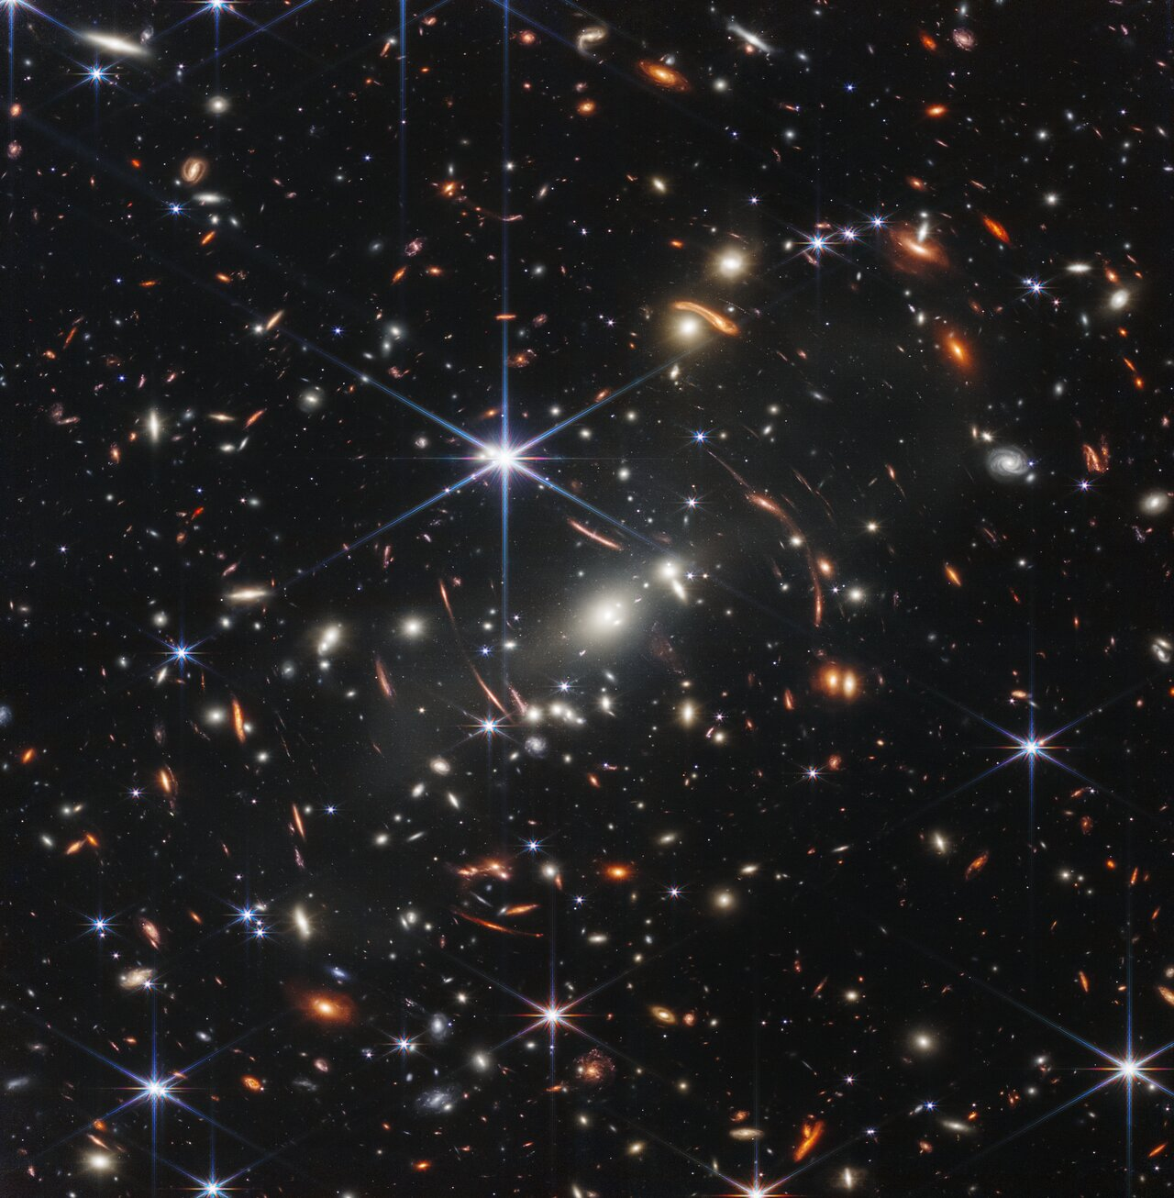
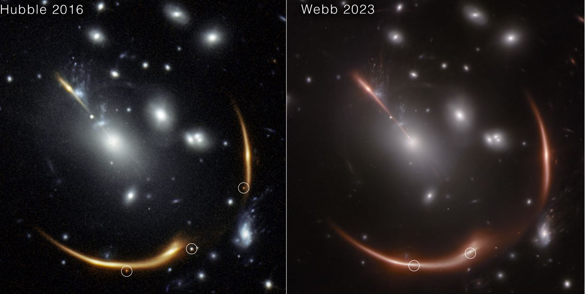
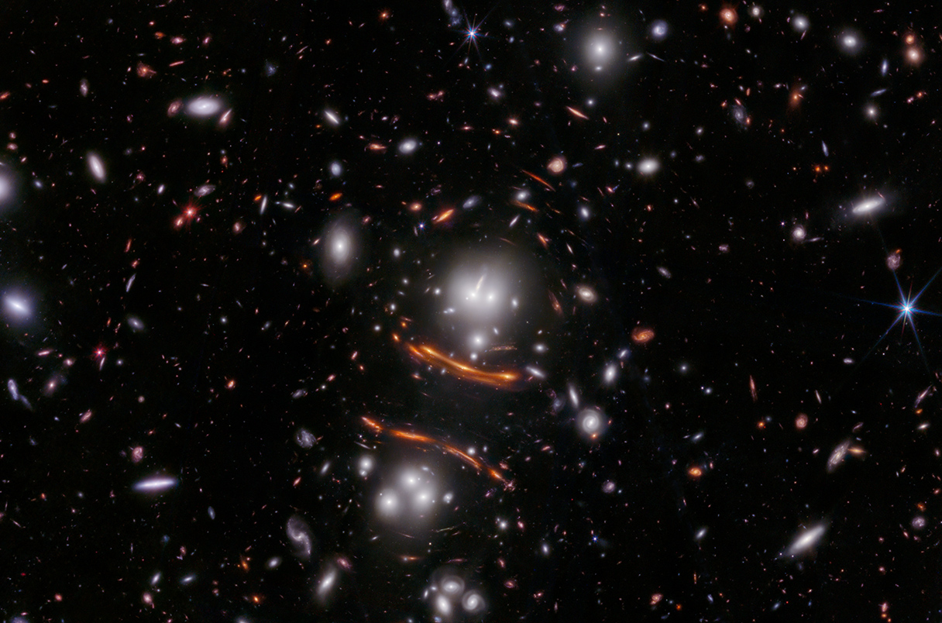
JWST is great at finding lenses

Slide 10
03
Research

Slide 11
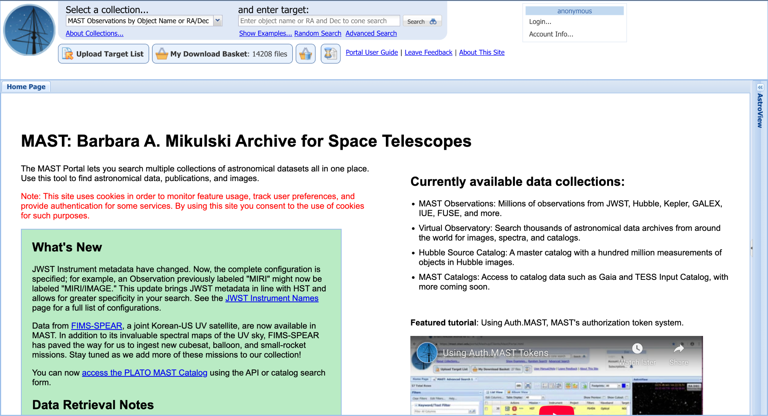
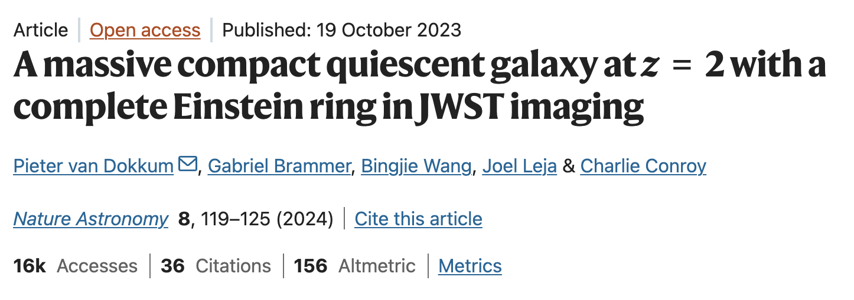

Paper QR Code:
Link

Slide 12

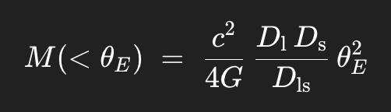
Einstein Radius
https://en.wikipedia.org/wiki/Einstein_radius#/media/File:Gravitational_lens_geometry.svg

Slide 13
Spectroscopy!

Slide 14
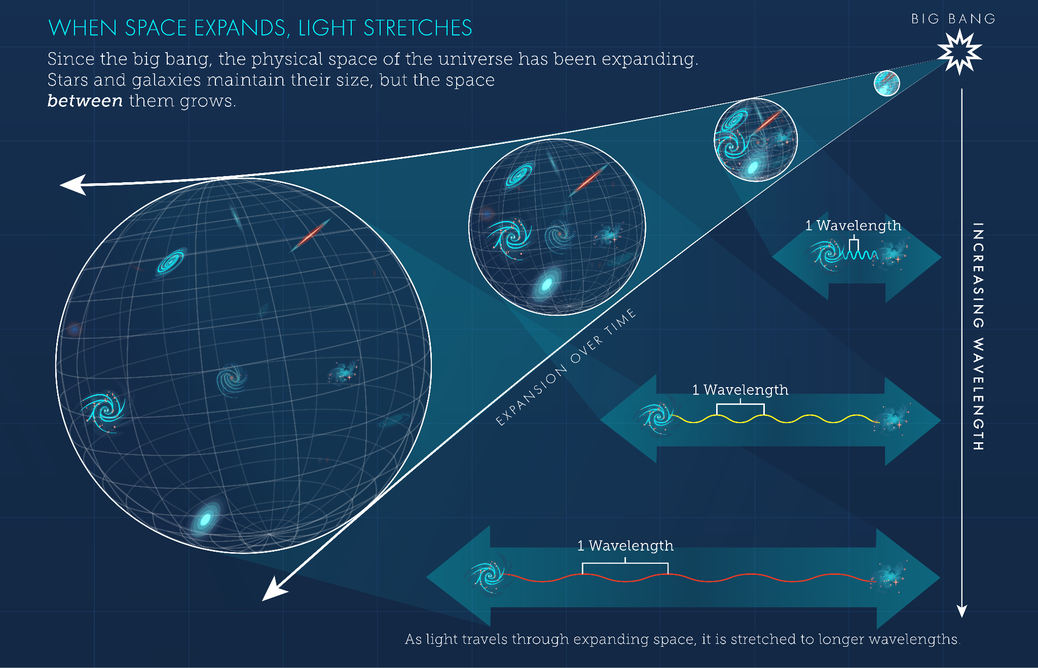
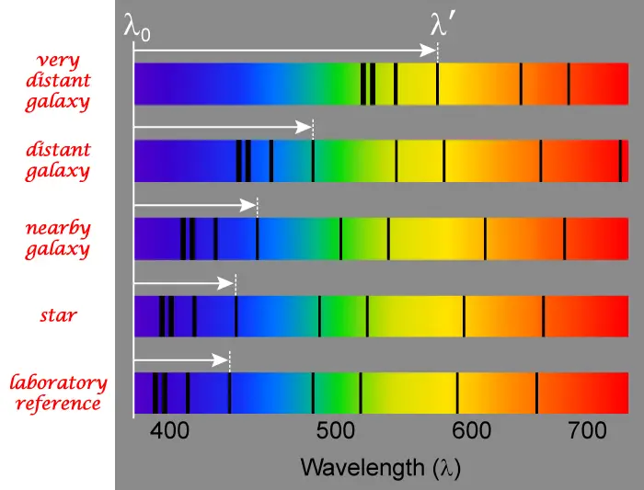
https://science.nasa.gov/mission/hubble/science/science-behind-the-discoveries/hubble-cosmological-redshift/
https://www.universetoday.com/articles/a-new-way-to-measure-the-expansion-rate-of-the-universe-redshift-drift

Slide 15
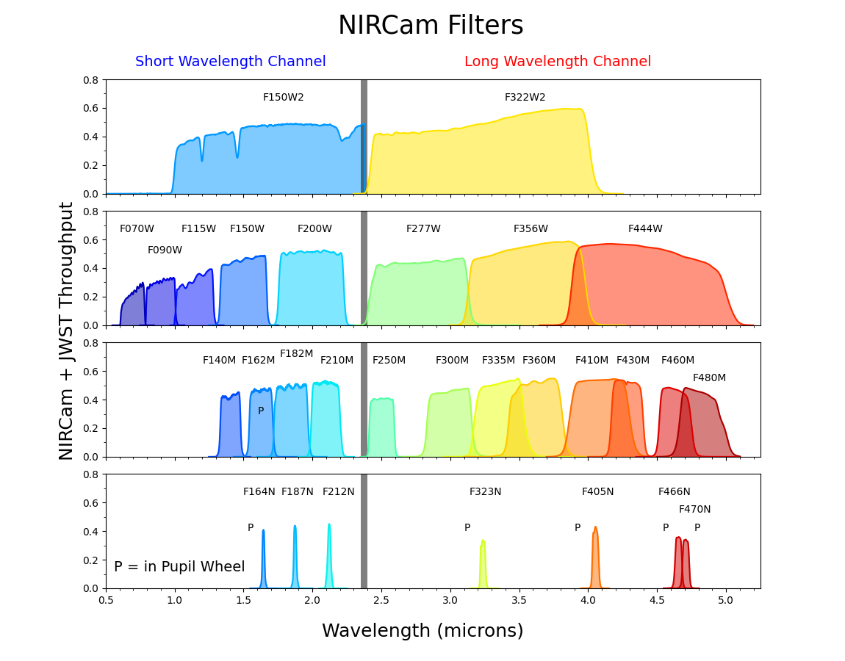
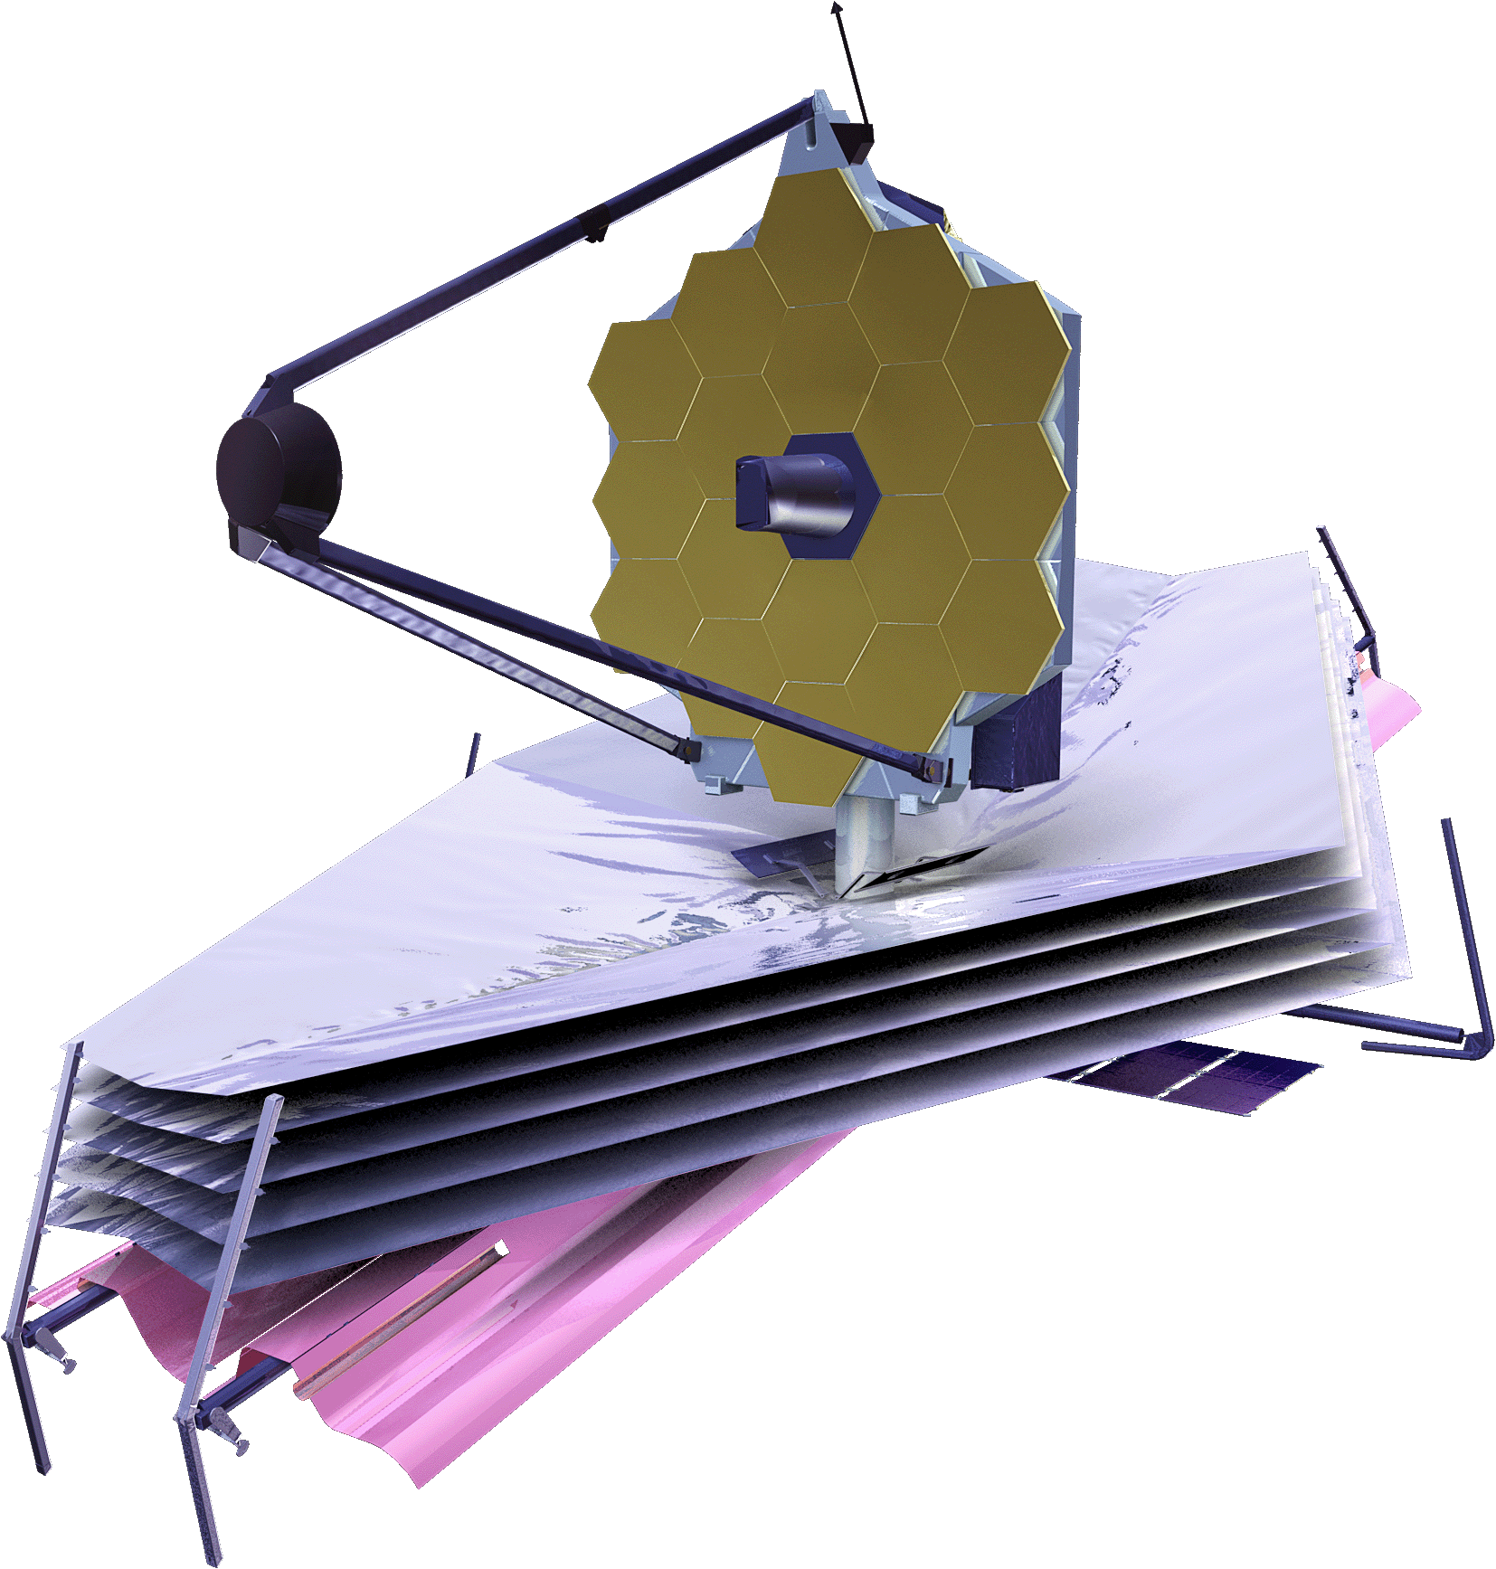
*NOT ACCURATE COLORS
https://jwst-docs.stsci.edu/jwst-near-infrared-camera/nircam-instrumentation/nircam-filters#gsc.tab=0

Slide 16

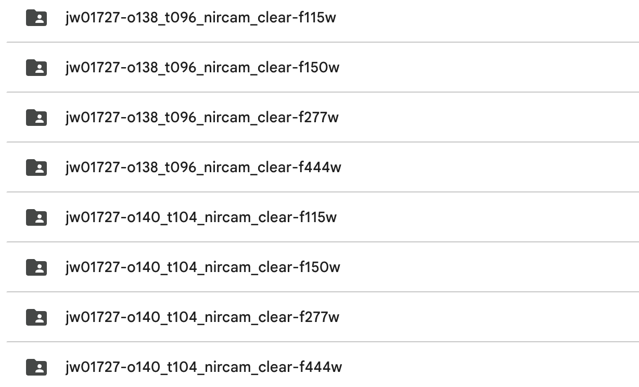


The following datasets were analyzed (nomenclature explanation):
Program ID 01727, Observation ID o140, Target t104 (the region where JWST-ER1 is located in the JWST data map). Focused on nircam data (0.6 - 5.0 µm | 2.07 - 0.248 eV), using no additional filters (clear).
Link

Slide 17
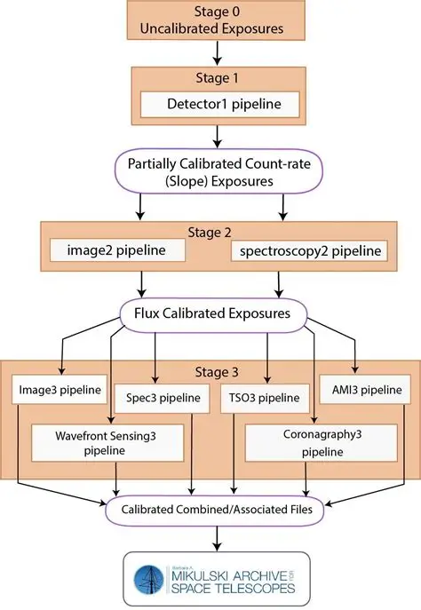
Extraction, Calibration, and Cleaning
Utilized the filters previously mentioned:
f115W: 1.013 - 1.282 µm | 1.225 - 0.968 eV
f150W: 1.331 - 1.668 µm | 0.932 eV - 0.744 eV
f227W: 2.422 - 3.131 µm | 0.512 - 0.396 eV
f444W: 3.881 - 4.982 µm | 0.319 - 0.249 eV
Stage 0: Produces uncalibrated raw data products from single exposures in units of total DN (e.g., "uncal.fits")
Stage 1: Produces data products that have been corrected for certain detector effects and converted to units of DN/s (e.g., "rate.fits")
Stage 2: Produces calibrated data products from single or multiple exposures with world coordinates and photometric information (e.g., "cal.fits")
Stage 3: Produces calibrated data products resulting from the combination of multiple exposures into a single integrated product (e.g., "i2d.fits", "s3d.fits", "x1d.fits")
[9]
https://jwst-docs.stsci.edu/jwst-science-calibration-pipeline#gsc.tab=0

Slide 18
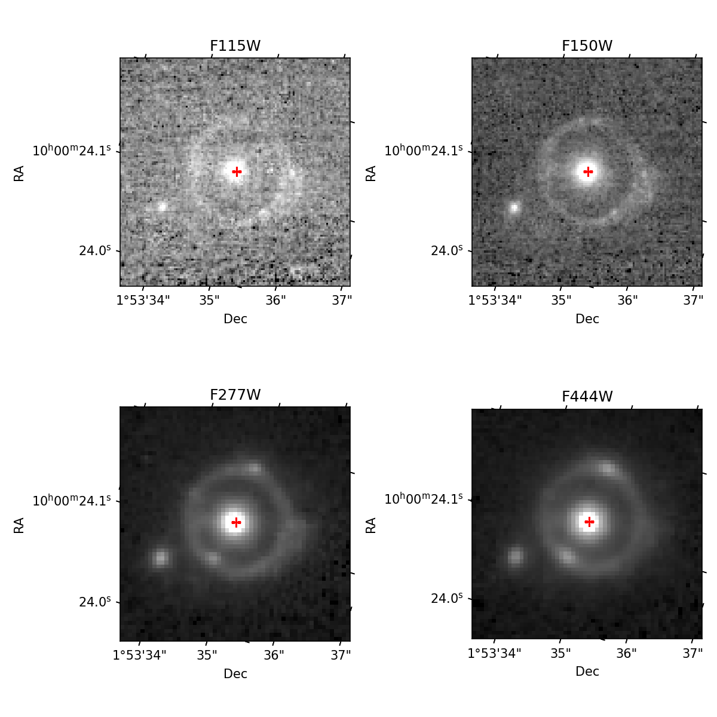

Slide 19
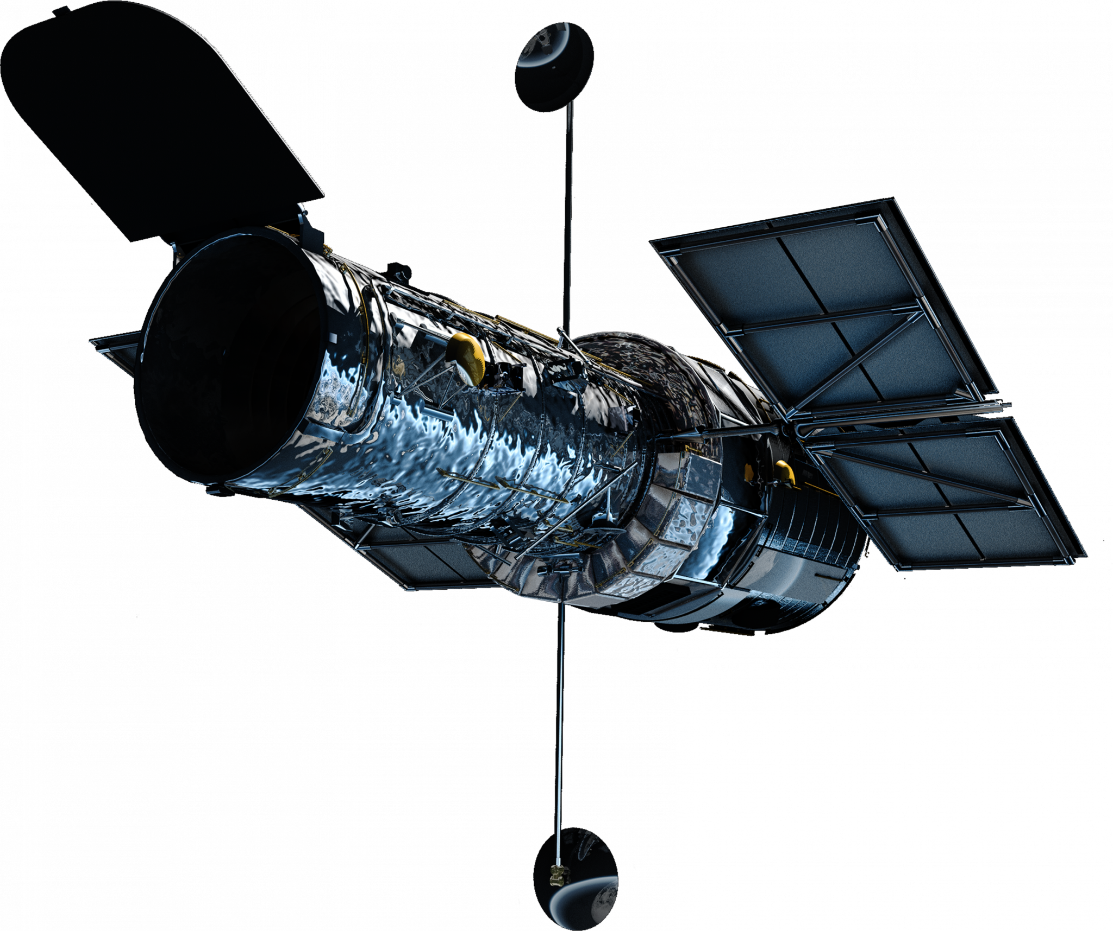
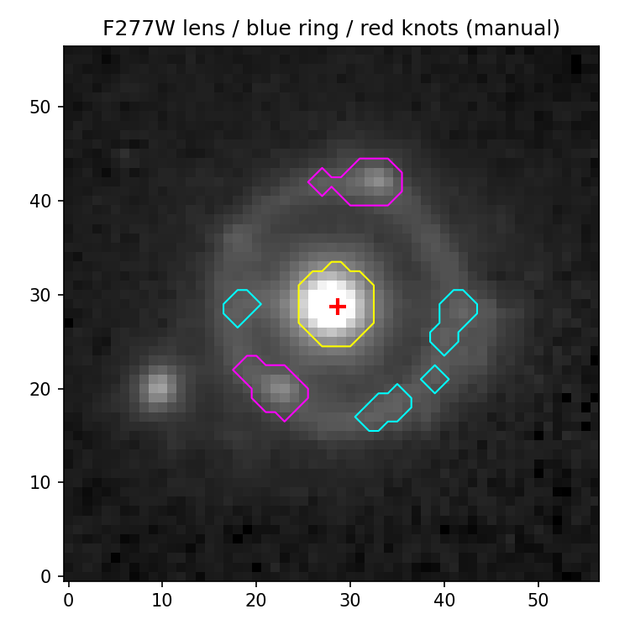
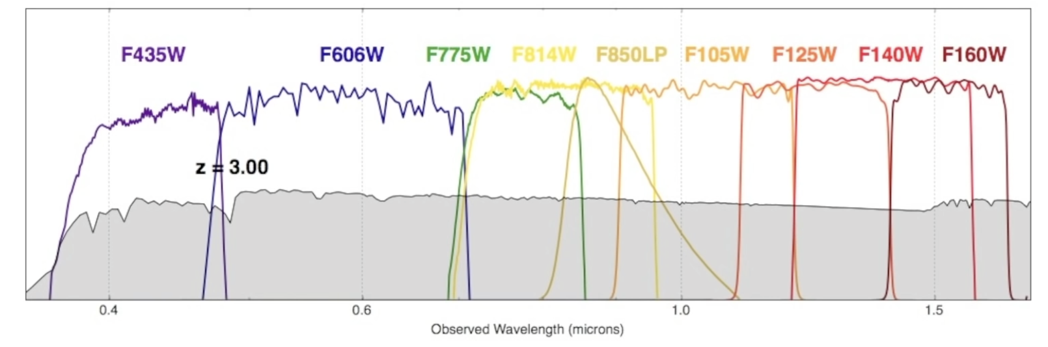

Slide 20
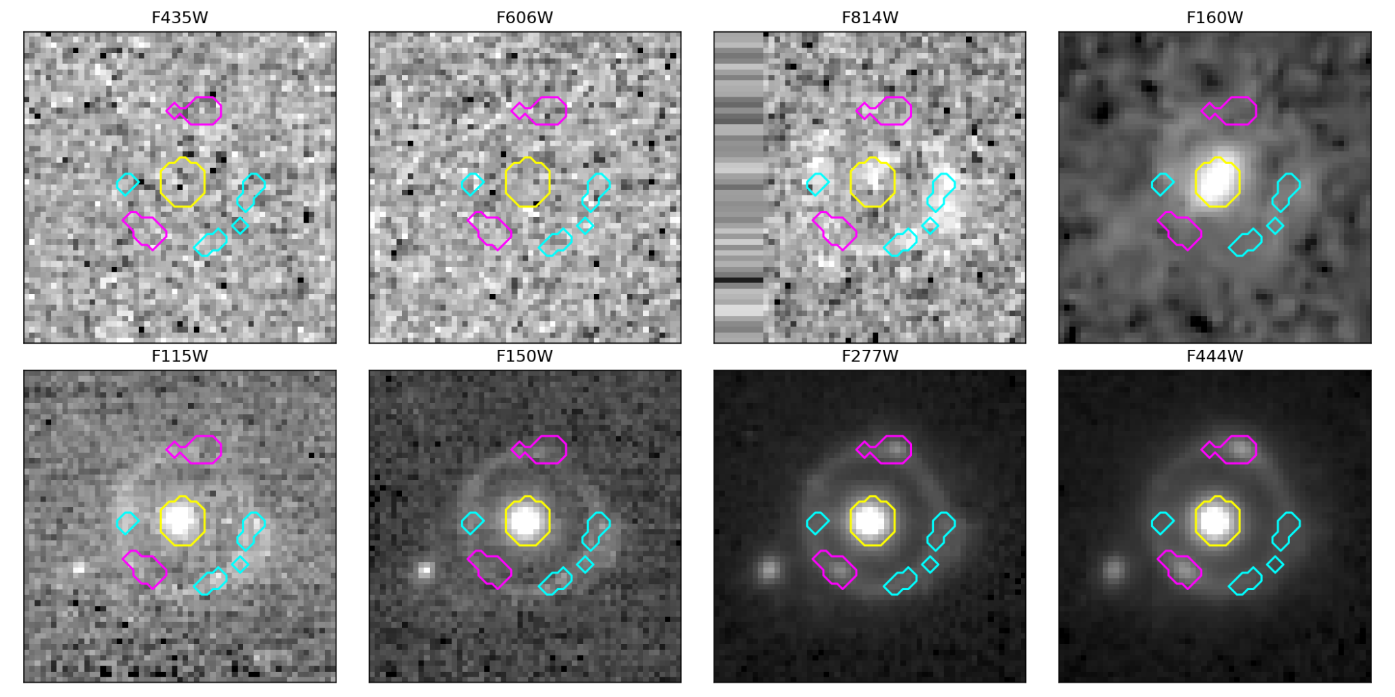

Slide 21
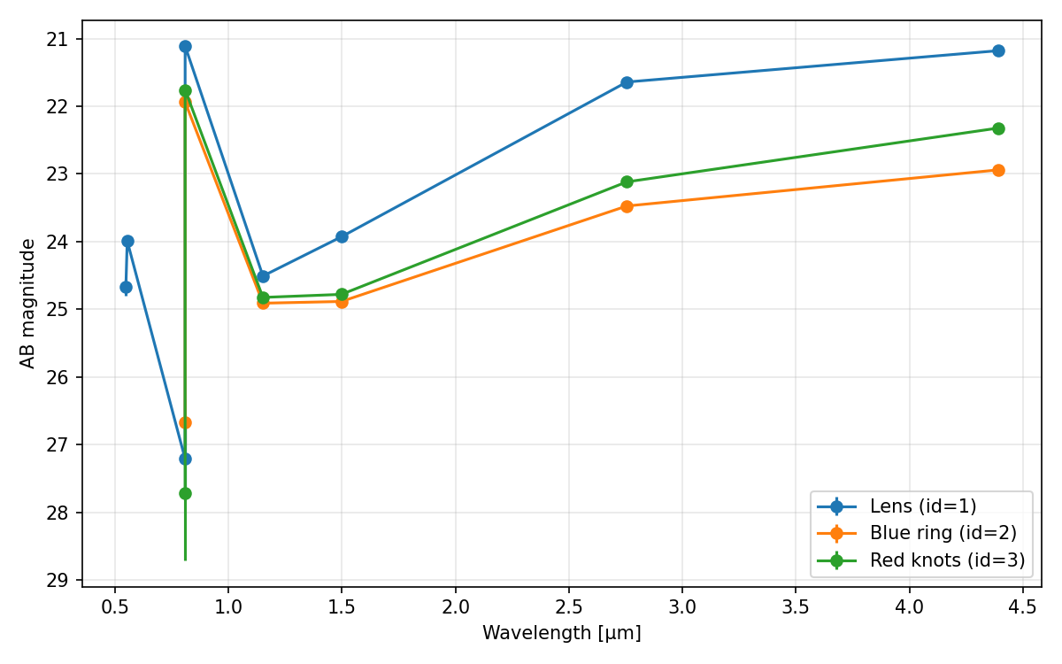
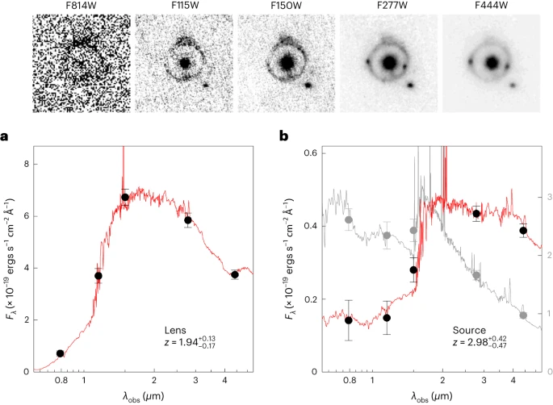
https://www.nature.com/articles/s41550-023-02103-9

Slide 22
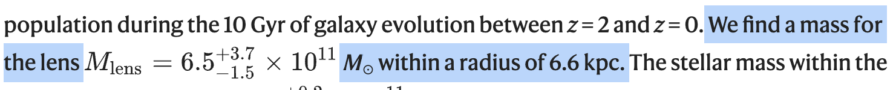
D_{L} = 1602.057 Mpc
D_{s} = 1179.631 Mpc
D_{LS} = 259.446 Mpc
M(<θ_{E}) = 3.220 * 10¹¹ M_{Sun}
R_{E} (physical) = 4.66 kpc

Slide 23
close enough!

Slide 24
03
Conclusions

Slide 25
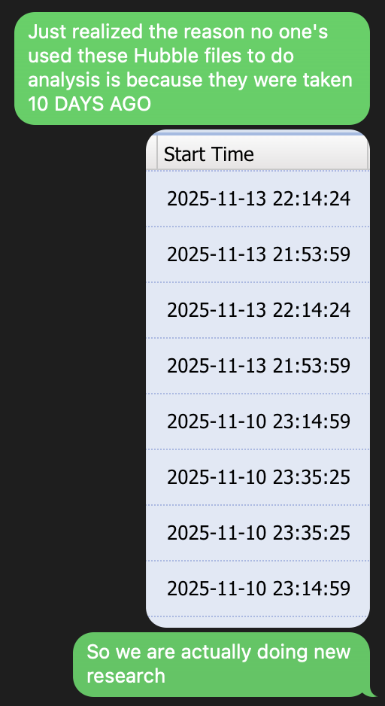


Conclusions
Photometric Redshift fitting is HARD.
Science can be overturned
Gravitational lensing is cool
This may have been overkill and we should have asked for more time

Slide 26


Check out the project code here:
Citations Page:
Link
Link

Slide 27
Thank you!
Questions?

